Slide 1




Slide 1
Data Analytics Portfolio
Syed Abdul Rasheed

Slide 2

Hi I am Syed Abdul Rasheed and
welcome to my portfolio
Mission Statement
“As a data analyst in the Aerospace industry in Augsburg, I am committed to using my extensive international experience and strong Technical skills to help improve the sector to be more efficient and sustainable. With a hands-on mentality, team spirit, and project management & leadership skills, I am passionate about creating meaningful solutions and delivering impactful insights through data analysis.
Lets Get Started

Slide 3





Projects
GameCo
Flu Season
GameCo
Analysing global video game sales
Preparing for Influenza Season
Predicting staffing needs based on historical data.
Rockbuster Stealth
Movie Rental Analysis with SQL
Instacart Grocery Sales Analysis
Customer Analysis and profiling with Python
USA Airport Dataset Analysis
Statistical Analysis, Regression and Clustering with Python
Tools
USA Airport
Rockbuster Stealth
InstaCart

Slide 4




GameCo
Objective: Perform a descriptive analysis of a video game sales data set for a fictitious company – GameCo, which wants to use data to inform the development of new games.
Data:
Global retail video game sales from 1980 to 2020. Data provided by VGChartz
Skills:
Data integrity, quality and accuracy checks
Data Cleaning
Data Grouping & Summarising (Pivot Tables)
Descriptive analysis
Visualising results in Excel
Tools:

Slide 5
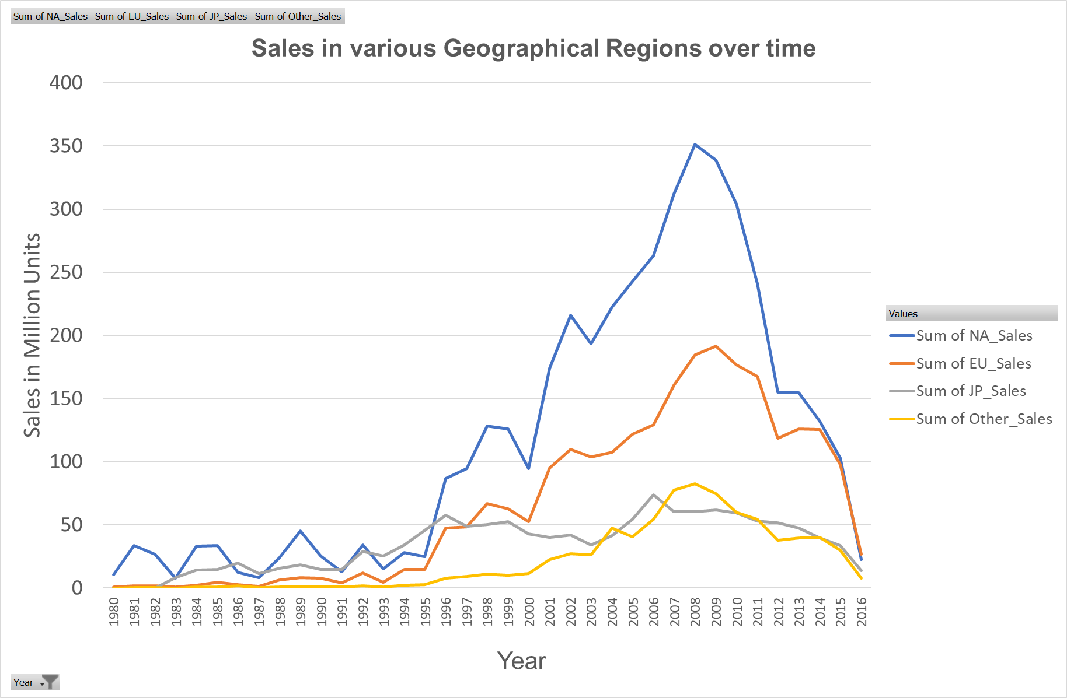
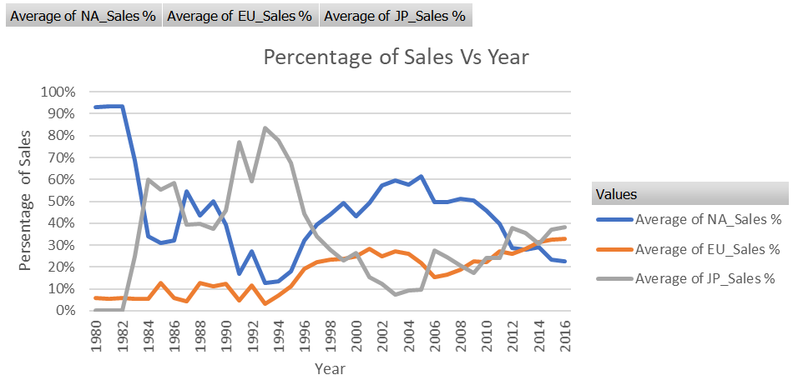
Identifying sales trends over time
Analysis of historical retail sales data:
Different sales regions
Trends and patterns identification
Recognise data limitations

Slide 6
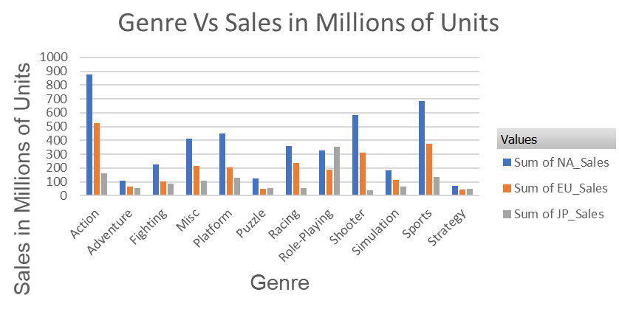
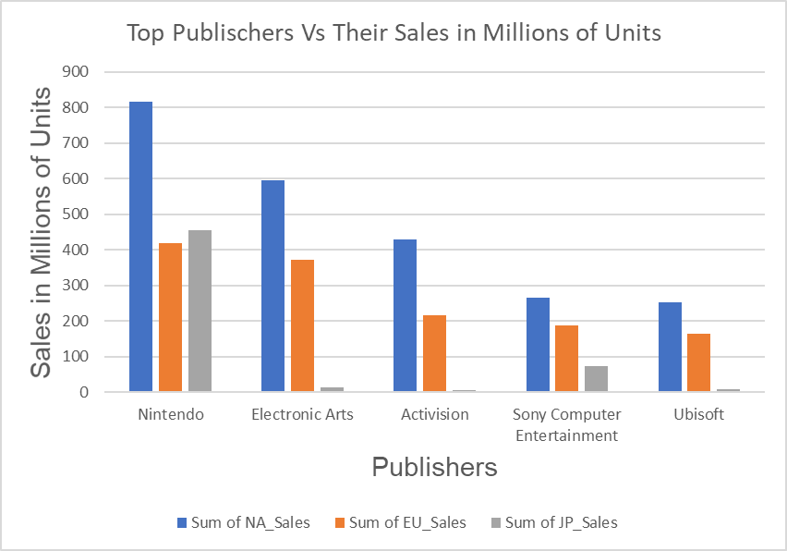
Identifying top genres and publishers
Top Genres
Action and sport games are the best selling in NA, followed by shooter
We see the same trend for the EU
In Japan the top selling genre is role playing, followed by action games
Top Publishers
Nintendo is the best selling publisher in all regions
Electronic arts is the second most popular publisher in NA
In Japan the concurrence of Nintendo is massive compared to all other publishers

Slide 7

Recommendations
Step 1
Investigate reasons for sharp decline in sales after 2008, including:
Online free games
Changes in consumer behaviour
Economic climate
Step 1
Step 3
Study factors that made Japan a successful market for video games in the 80s and 90s
Step 2
Step 4
Step 4
Investigate reasons for decline in North America(NA) sales:
Increase marketing budget
Investment strategy for Europe(EU):
Growing steadily
Invest current budget
Investment strategy for Japan:
On the rise
Continue with current budget
Step 2
Drive sales and attract customers:
Focus on best-selling genres and publishers
Expand reach and increase sales:
Create an online gaming platform
Step 3
Final Presentation

Slide 8
Flu Season
Objective: Provide recommendations to a medical staffing agency to inform the timing and spatial distribution of additional medical personnel for the upcoming Influenza season in the United States.
Data:
Influenza deaths - Data Set Source: CDC
Population data - Data Set Source: US Census Bureau
Skills:
Designing a Data Research Project
Data Profiling & Integrety Checks
Data Integration & Transformation
Statistical Analysis
Statistical Hypothesis Testing
Data Visualization & Storytelling (Tableau)
Tools:

Slide 9
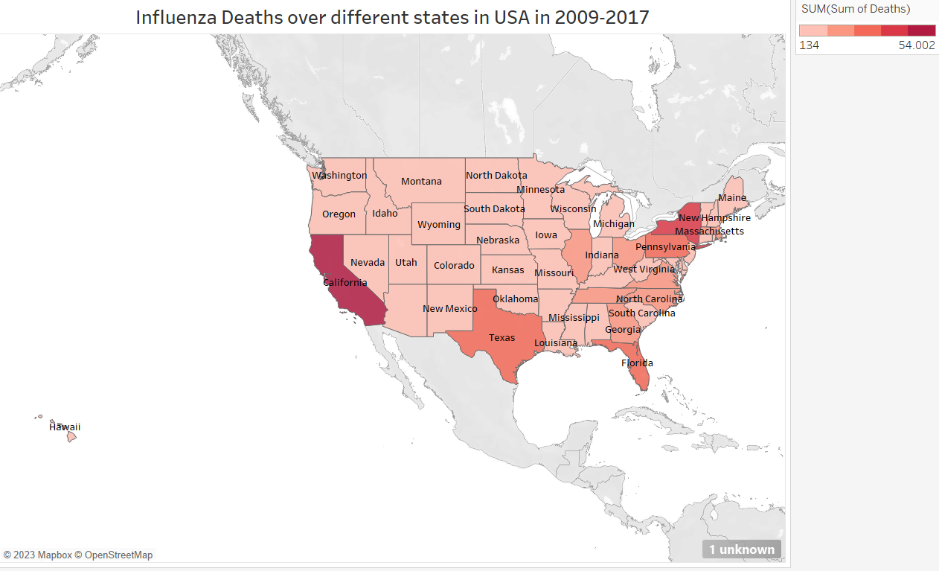
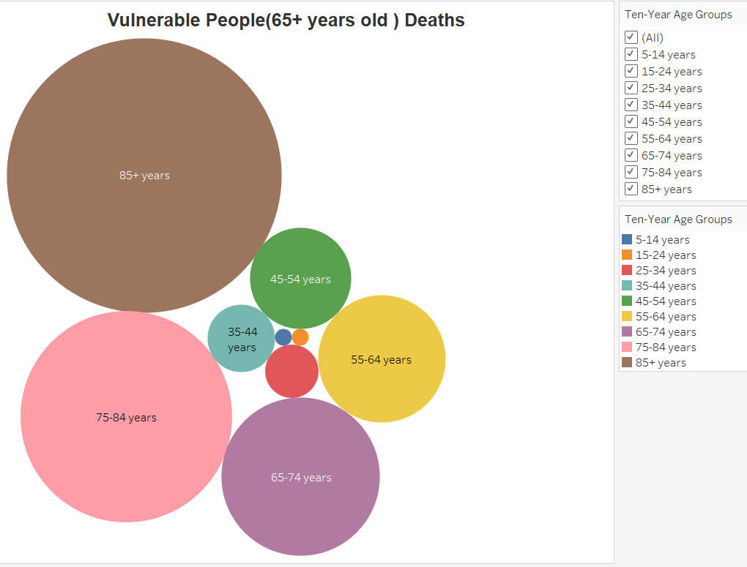
Influenza deaths in USA & Vulnerable People Deaths
Influenza deaths in different states in USA
Influenza deaths are High in California, New York and Texas
The flu deaths for Alaska have been suppressed
Vulnerable People Death
Among Vulnerable People (65+ Years old), 85+ years people deaths are high
Second highest deaths are in 75-84 years old

Slide 10
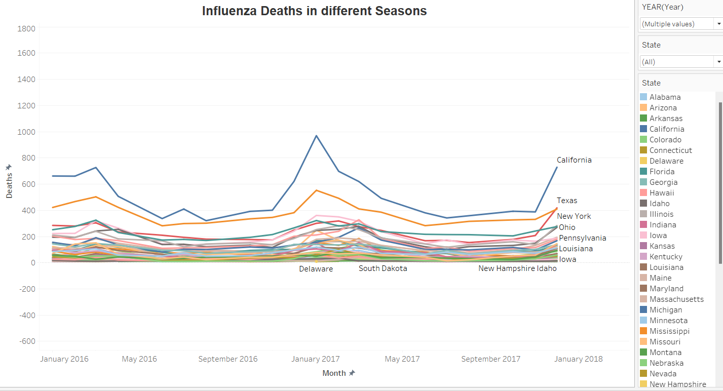
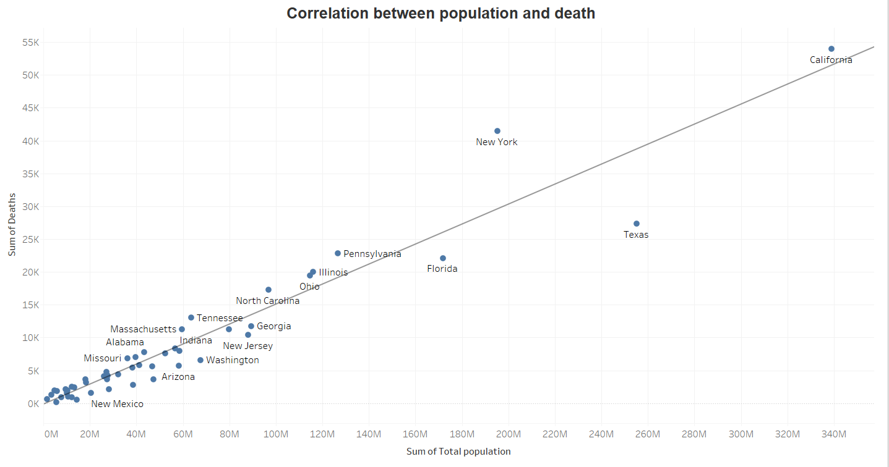
Influenza deaths in different Seasons & Correlation
Influenza deaths in different Seasons
Influenza deaths are High in October to April months
Peak deaths are in January month
Influenza season is not same for every state
Correlation between population and deaths
There is a positive correlation between Total Population and deaths
Square Root of 0.92(R-squared) = 0.95
Correlation = 0.95
Means Strong Relation Ship(0.5-1.0)

Slide 11
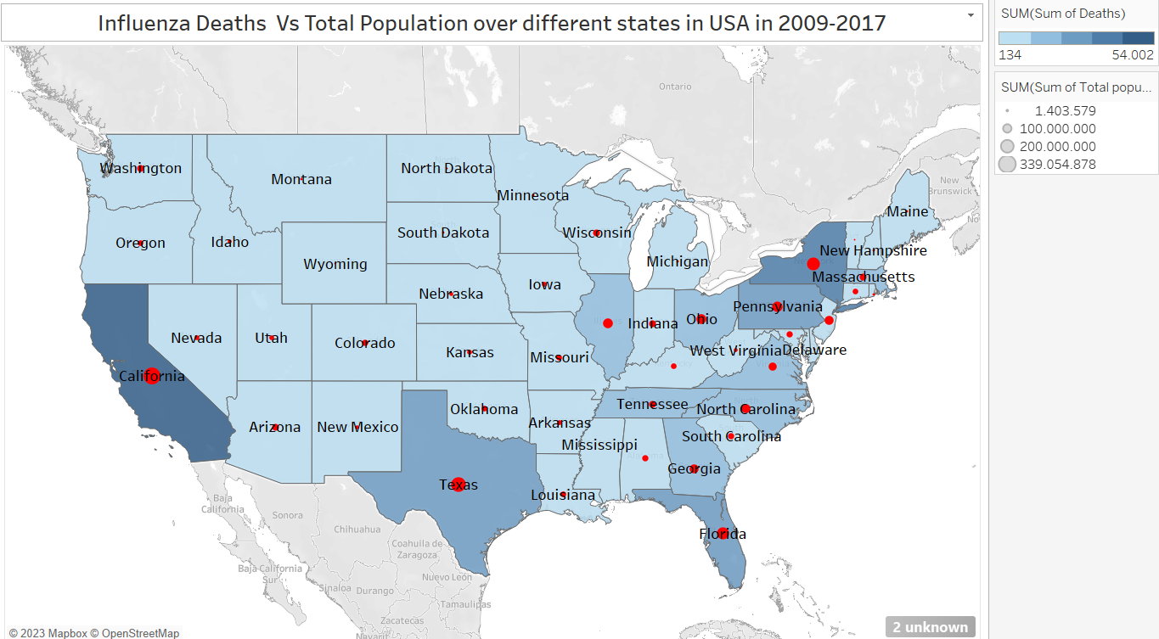
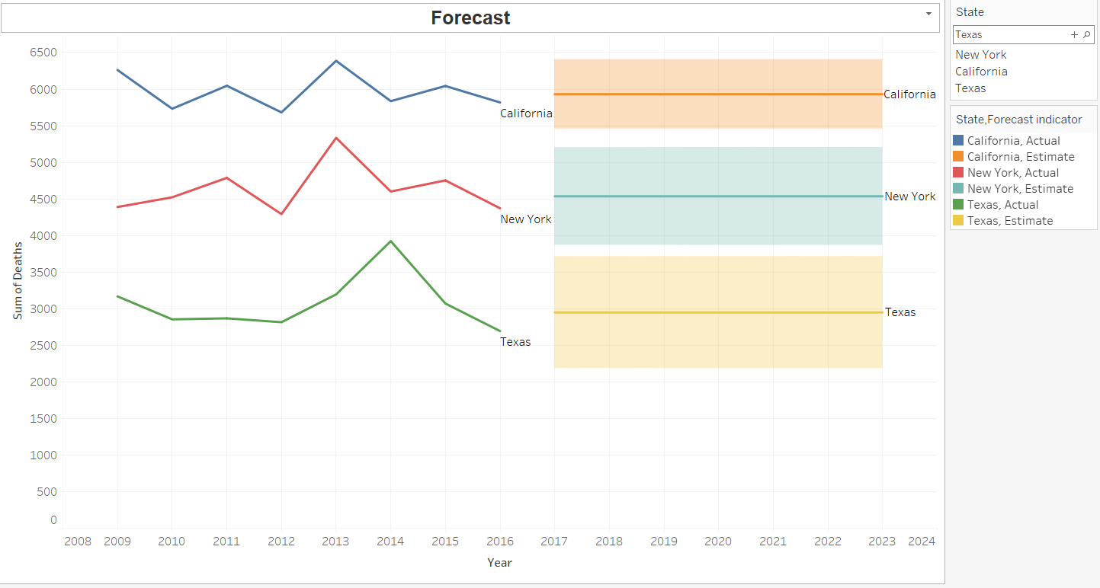
Density of Total population & Forecast
Distribution of vulnerable population
Total population and flu deaths
The flu deaths for Alaska have been suppressed
Forecast for 2018-2023
Using the data from 2009-2017 we can forecast 2023
Using the forecast we can staff the accordingly the different states

Slide 12
Conclusions
Conclusion 1
The vulnerable group is 65+ years old and the most vulnerable group is 85+ years old
Conclusion 1
Conclusion 4
Conclusion 3
Conclusion 2
Conclusion 3
Since the Influenza season is not exactly the same time in all states, we can use it in order to move the extra medical staff around
Conclusion 4
Using the forecast for 2023 we can send the extra medical staff accordingly to the states with the most needs
Conclusion 2
Our analysis has showed which states and when need the most help
Tableau Story Board
Interim Report

Slide 13
Rockbuster Stealth LLC
Objective: Perform an analysis of a movie rentals database for a fictitious movie rental company – Rockbuster Stealth, which wants to transition to an online streaming service. Provide insights to inform the launch strategy.
Data:
Rockbuster database provided by CareerFoundry
Skills:
Relational Databases
Database Querying
Database Filtering
Database Cleaning & Joining Tables
Subqueries & Common Table Expressions
Data Visualization
Data Dictionary Creation
Tools:

Slide 14
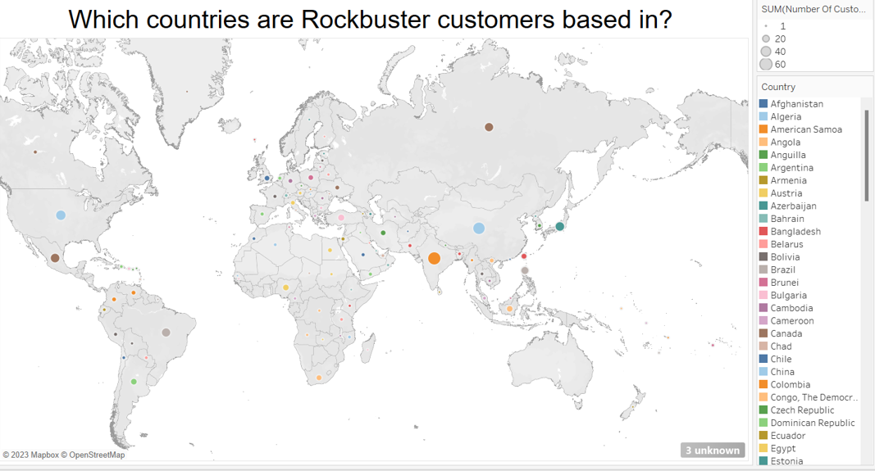
Global markets & customer size
108 Countries
Global Presence
This can be utilize for online streaming service launch

Slide 15
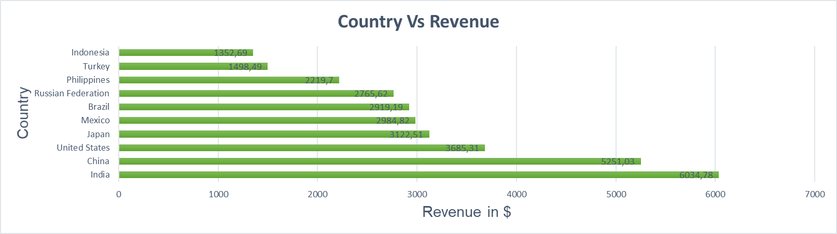
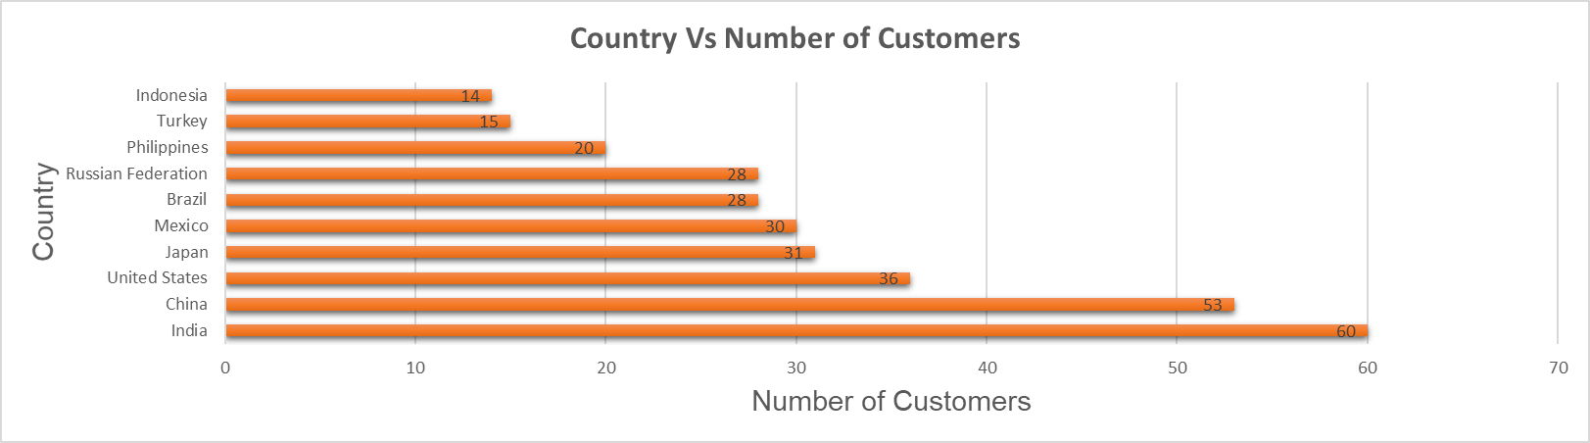
Global Revenue & customer size
6034,78$
Revenue
India has the highest revenue
60 Customers
India has highest customers
Using Postgre SQL to identify countries with the highest revenue and highest number of customer

Slide 16
Recommendations
Step 1
Leverage global customer base:
Rockbuster has customers around the world
Utilise this for online platform
Company name already known in all markets
Step 1
Step 3
Competitive online platform subscription:
Average spending per title: $2.98
Offer subscription for access to all titles
Competitive pricing (for a few more dollars per month)
Step 2
Step 4
Step 2
Create online platform
Focus on best-performing markets
Step 4
Improve "weak" markets:
Increase marketing budget
Target "weak" markets
Step 3
Data Dictionary
Full Presentation

Slide 17



Instacart Basket Analysis
Objective: : Perform analysis of customer orders in order to derive insights and suggest strategies for better segmentation based on sales patterns and customer purchasing behavior.
Data:
Instacart online grocery datasets provided by Instacart
Skills:
Data Analytics with Python
Data Cleaning & Combining
Data Wrangling & Sub setting
Data Consistency Checks
Deriving Variables
Data Grouping & Aggregation
Data Visualisation with various libraries
Tools:

Slide 18
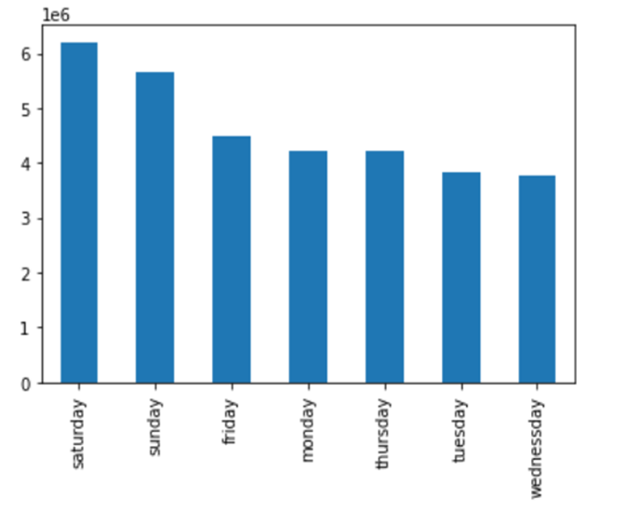
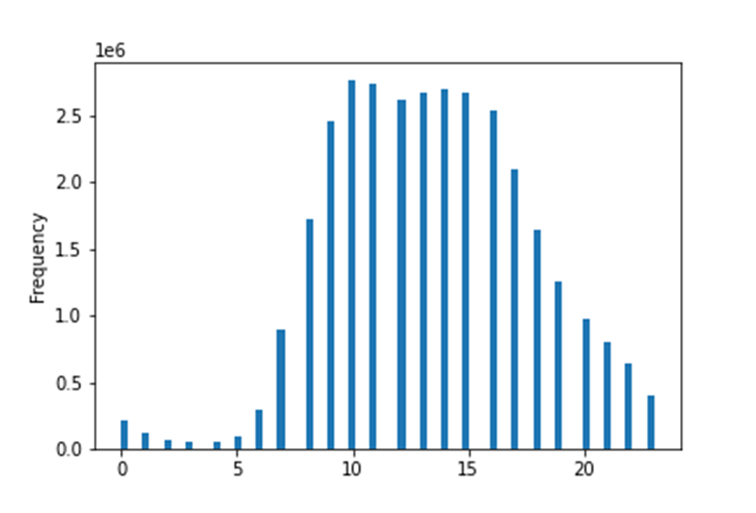
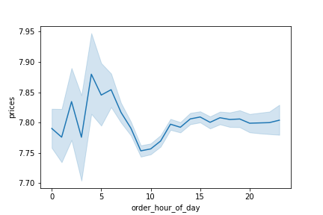
Sales data analysis with Python
Hours of the day
Saturday
9AM-4PM
3AM-5PM
Busiest day of the Week
Busiest hours of the day
Hours most expensive items bought
Exploratory Data Analysis using python.
Analysing sales data to identify times with most revenue (weekday, hour of day)

Slide 19
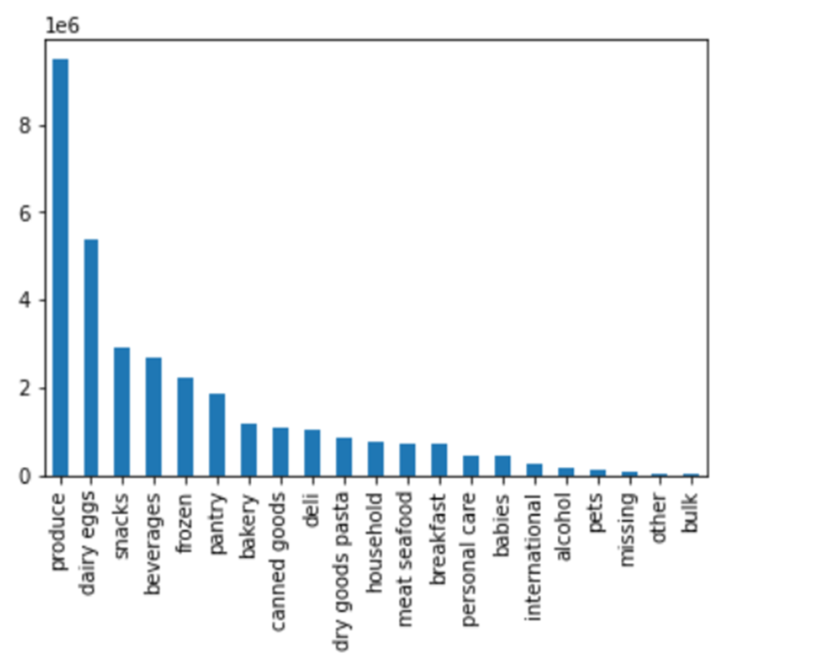
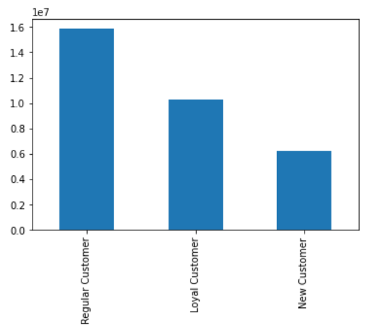
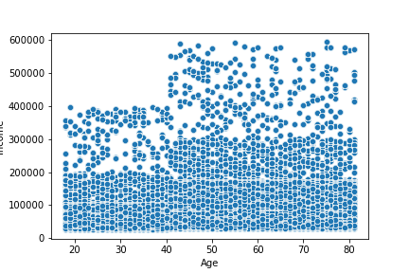
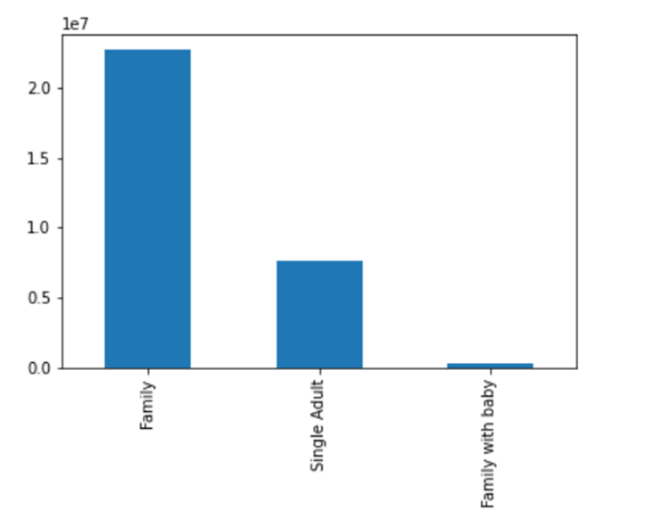
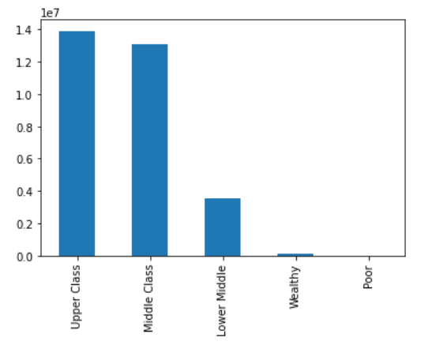
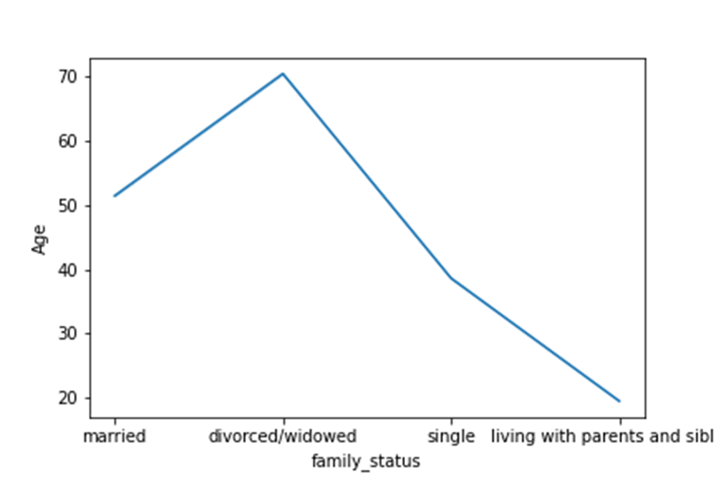
Customer profiling using Python
Populer Products
Customer Types
Relation between Age and Income
Income
Dependent Flag
Income Flag
Relation between Age and Family status

Slide 20
Recommendations
Step 1
Instacart should consider scheduling more targeted ads on the least busy days: Tuesday and Wednesday
Step 1
Step 3
Introduce a rewards program for loyal customers to incentivise more purchases. Also, target new customers with promotions and discounts
Step 2
Step 4
Step 2
Increased advertising during the late afternoon and evening hours starting around 5pm when there tends to be a decrease in customer orders
Step 4
Offer discounts and promotions for items in the departments with the fewest orders
Step 3
GitHub Repository

Slide 21

USA Airport Dataset Analysis
Objective: : Statistical Analysis of the USA Airport Dataset means analysing the Airport dataset to draw the relations between variables of the dataset and show the insights.
Data:
USA Airport dataset taken from Kaggle
Skills:
Data Analytics with Python
Data Cleaning & Wrangling
Data Consistency Checks
Pair plots & Hypothesis derivation
Hypothesis testing with Regression
Clustering and Grouping the Clusters
Data Visualisation with various libraries
Tools:

Slide 22
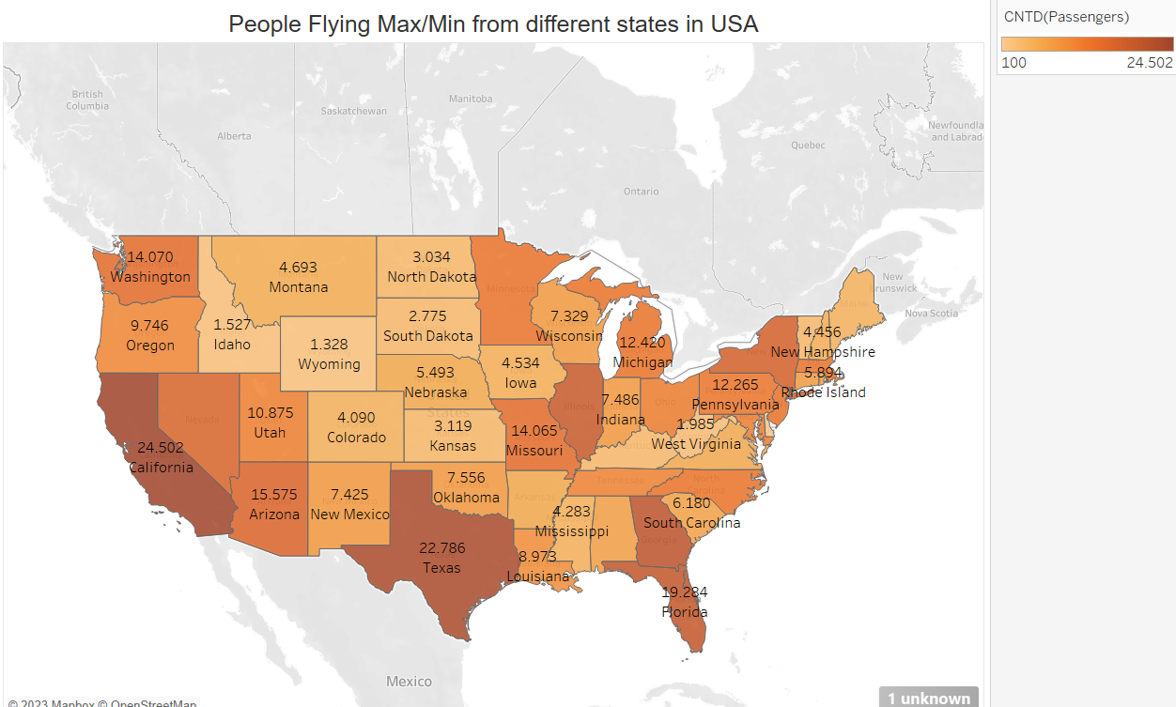
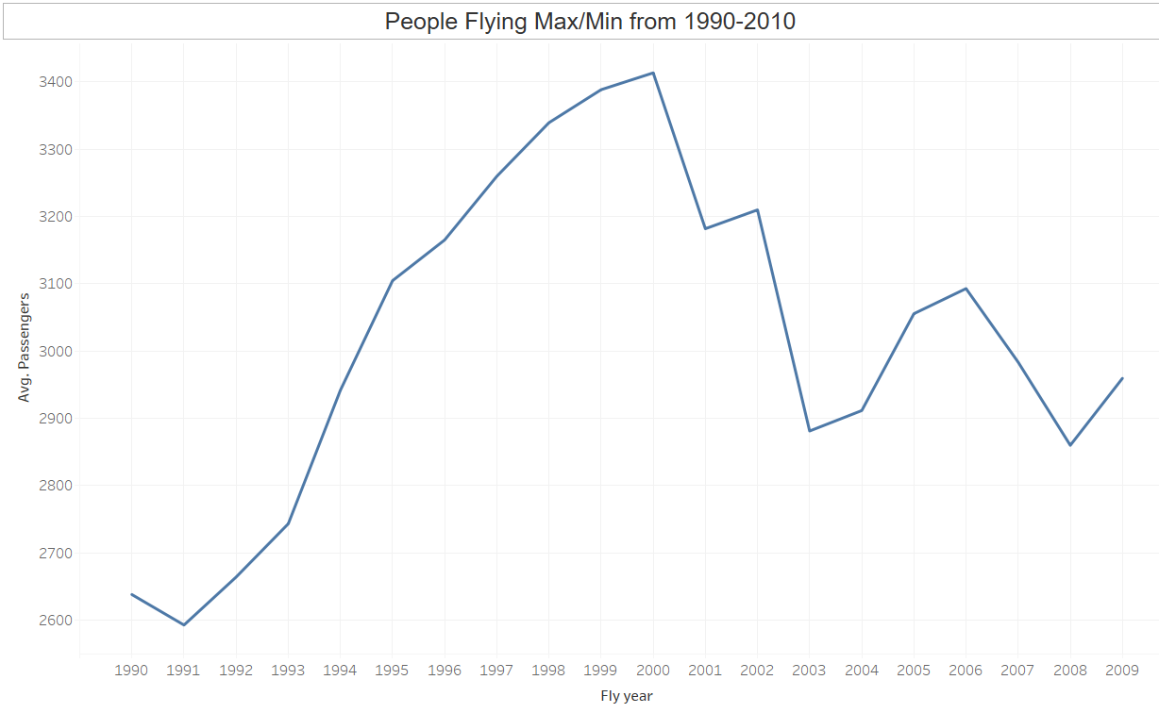
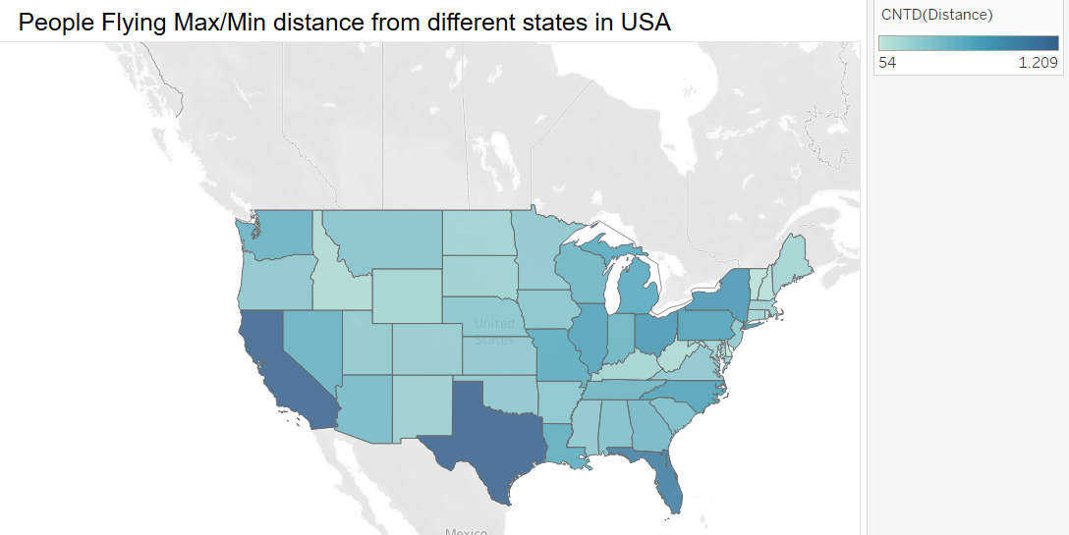
USA Airport data analysis with Python
California&
Texas
Long Distance
2002
- People in California and Texas are flying maximum
- People in Delaware are flying minimum
-Flights are full with passengers in 1997-2000.
-Flights are less occupied with passengers in 2002
- People in California are flying long distances

Slide 23
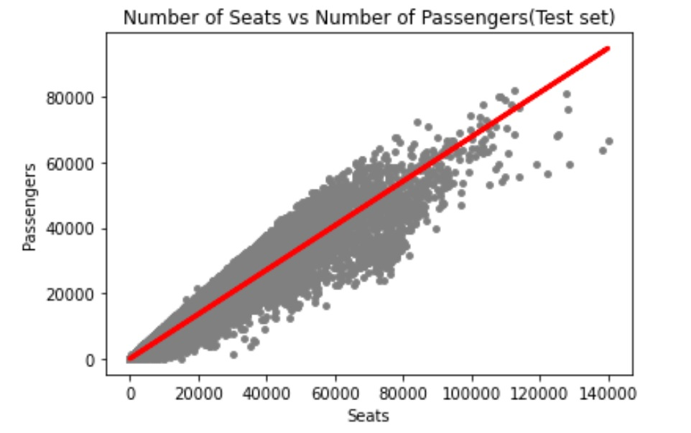
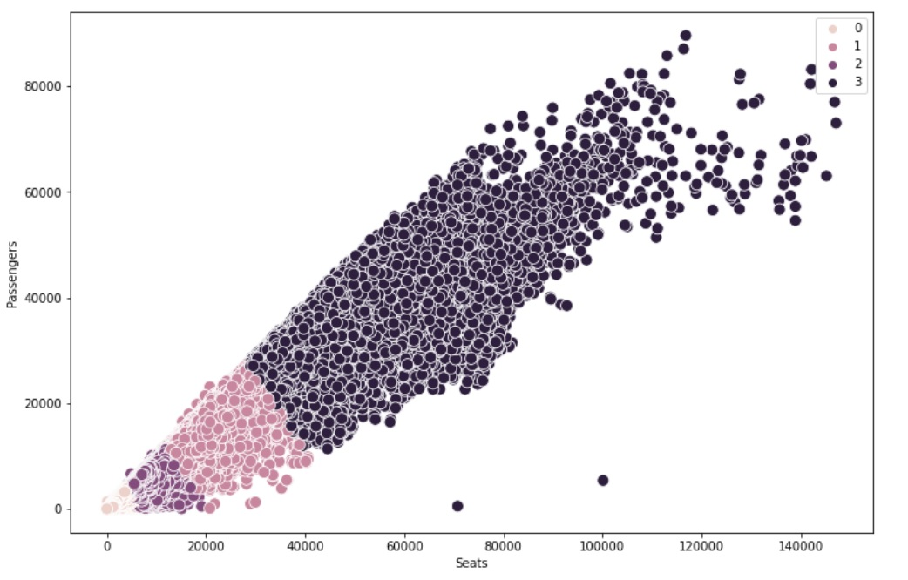
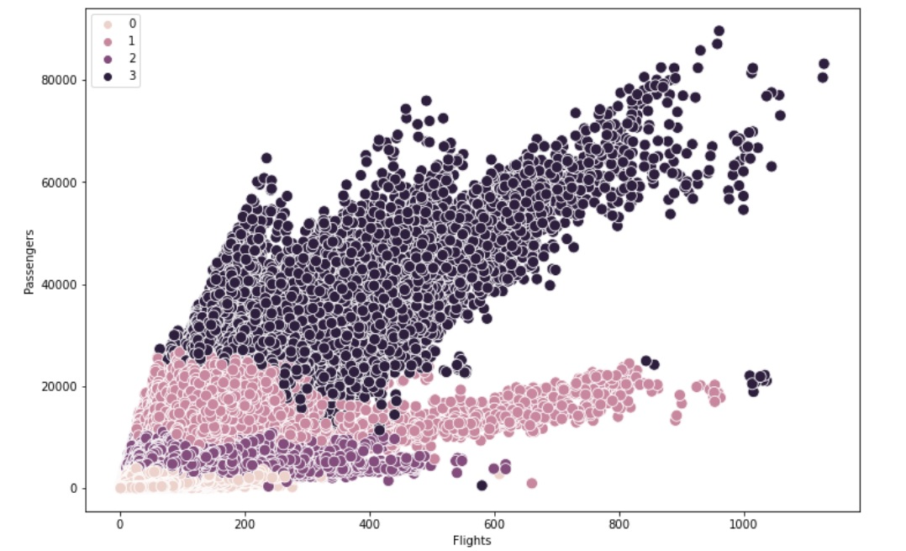
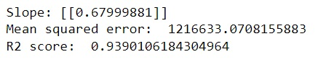
Linear Regression & Clustering using Python
Linear Regression
Clusters: Seats & Passengers
Clusters: Flights & Passengers
-For lesser passengers only single aisle flights are sufficient. for increased passengers require more seats means large seating capacity flights are require to operate.
Linear Regression Analysis has been Carried out between Passengers and Seats variables.
Here the R^2 value = 0.93. This means the model fitted is 93.78%.It fitted perfectly

Slide 24
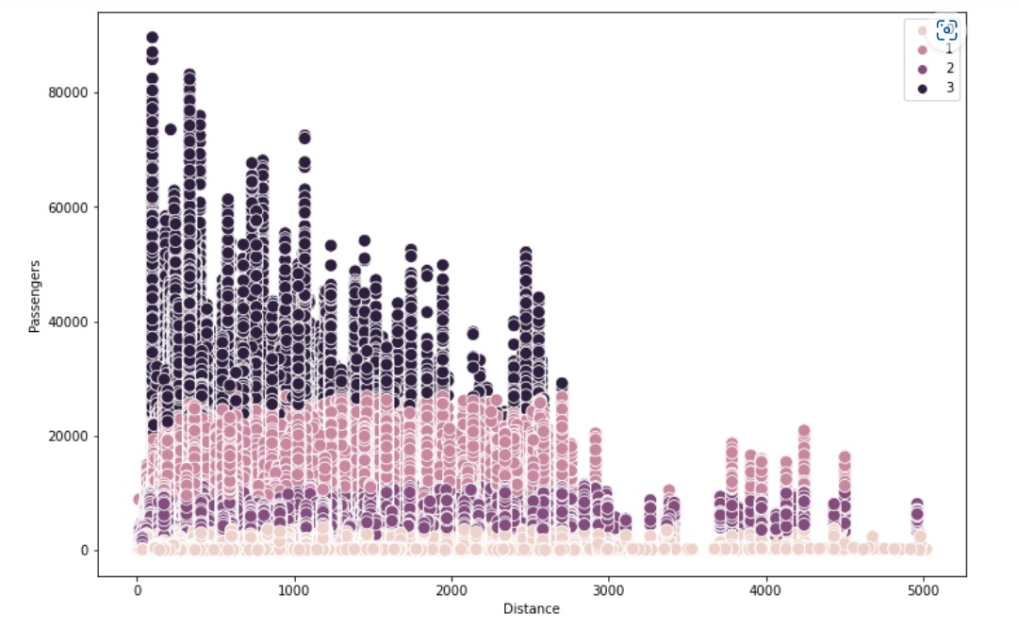
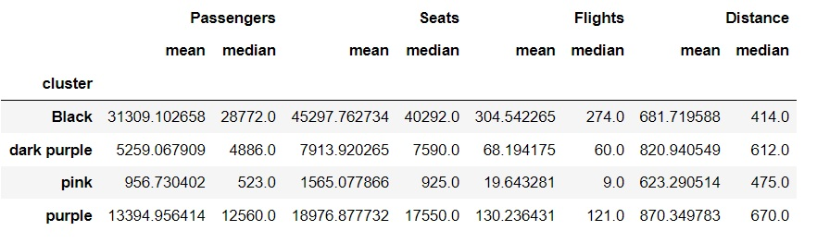
Clustering & Grouping of Clusters using Python
Clusters: Distance & Passengers
Grouping the Clusters by its Colors
- Why this Cluster number '3' passengers only travelled 2600 miles need to further investigate?

Slide 25
Recommendations & Further Analysis Required
Step 1
Why the Cluster number '3' passengers only travelled 2600 miles need to further investigate?
Step 1
Step 3
Cluster Black Passengers are the Least distance travellers. Need to find the reason for this?
Step 2
Step 4
Step 2
Cluster Pink passengers are the least number of passengers but they travel more distance than the cluster Black Passengers. The Reason for this need to find?
Step 4
Cluster Black Passengers require Highest seats and Highest number of flights than others. Need to find the reason for this?
Step 3
Tableau Story Board
GitHub Repository

Slide 26

Slide 10
THANK YOU

